Slide 1
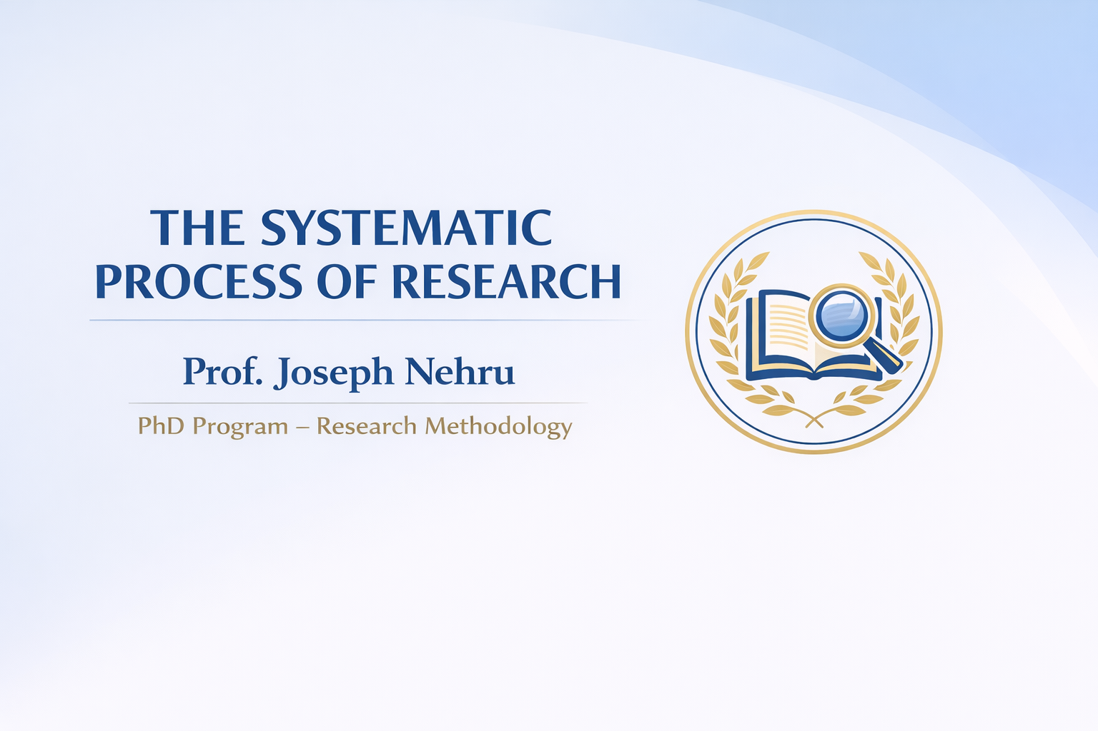
‘
Notes:
The Systematic Process of Research
Good day everyone.
In this lecture, we will discuss the systematic process of research, which is a fundamental concept in research methodology, particularly for doctoral-level studies.
Research is not a random or unstructured activity. Rather, it follows a logical and systematic sequence of steps that guide researchers in identifying problems, collecting data, analyzing evidence, and presenting meaningful findings.
Understanding this systematic process is essential for conducting rigorous and credible academic research.
In this session, we will explore the major stages involved in the research process, beginning with identifying a research problem and moving through various stages such as formulating research questions, reviewing literature, designing the study, collecting and analyzing data, and finally reporting the research findings.
This lecture is part of the PhD program in Research Methodology.
Let us now begin by understanding what research actually means and why a systematic process is necessary for scholarly inquiry.

Slide 2
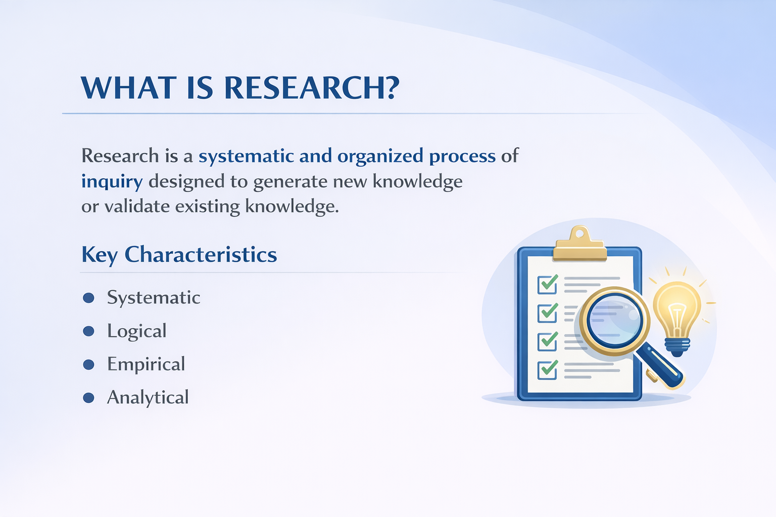
Notes:
What is Research?
Let us begin by understanding what research actually means.
Research can be defined as a systematic and organized process of inquiry that aims to generate new knowledge or validate existing knowledge. In other words, research is a structured effort to investigate questions, explore problems, and discover reliable answers through careful study and analysis.
In academic contexts, research plays a crucial role in expanding knowledge, improving professional practices, and developing new theories and insights within a field of study.
Research generally possesses several important characteristics.
First, research is systematic. This means that it follows a clearly defined sequence of steps, rather than being conducted randomly or without structure.
Second, research is logical. Researchers use reasoning and critical thinking to develop arguments, interpret evidence, and reach meaningful conclusions.
Third, research is empirical. This means that research relies on evidence obtained through observation, experience, or data collection.
Finally, research is analytical. Researchers carefully examine and interpret the collected information in order to understand patterns, relationships, and implications.
Together, these characteristics ensure that research remains a rigorous and credible process of knowledge creation.

Slide 3
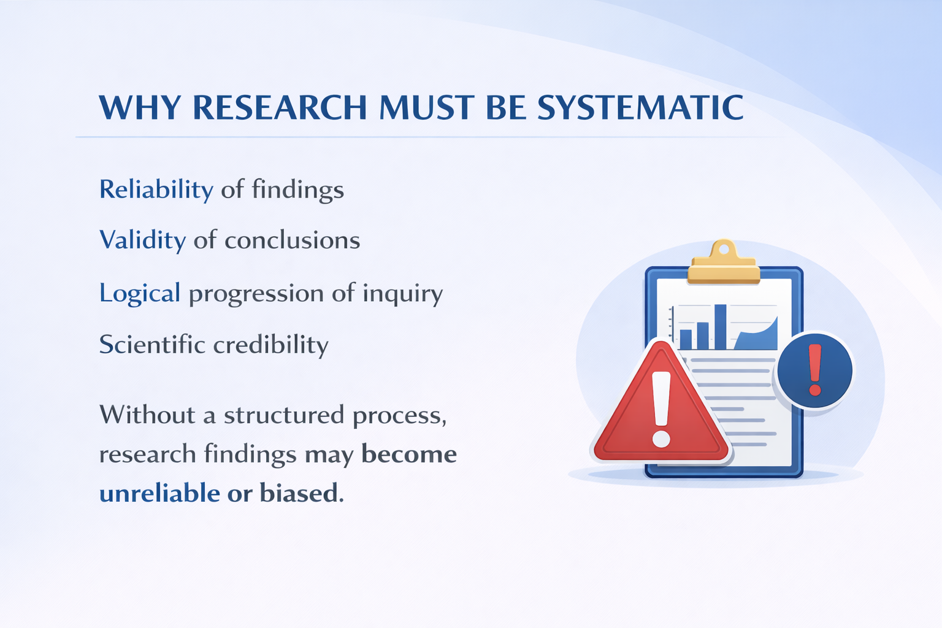
Notes:
Why Research Must Be Systematic
At this point, it is important to understand why research must follow a systematic process.
Research that is conducted in a structured and organized manner produces reliable findings. Reliability refers to the consistency and dependability of the results obtained through the research process.
A systematic approach also strengthens the validity of conclusions. Validity means that the conclusions drawn from the study accurately reflect the reality that the researcher is investigating.
Another important reason is the logical progression of inquiry. When research follows a clear sequence of steps, each stage of the investigation builds upon the previous one. This logical flow helps researchers maintain clarity and coherence throughout the study.
In addition, a systematic process enhances the scientific credibility of the research. Studies that follow established methodological procedures are more likely to be accepted and trusted by the academic community.
On the other hand, if research is conducted without a clear structure or methodological discipline, the findings may become unreliable or biased, which can weaken the value and impact of the study.
Therefore, adopting a systematic approach is essential for producing rigorous and credible research outcomes.

Slide 4
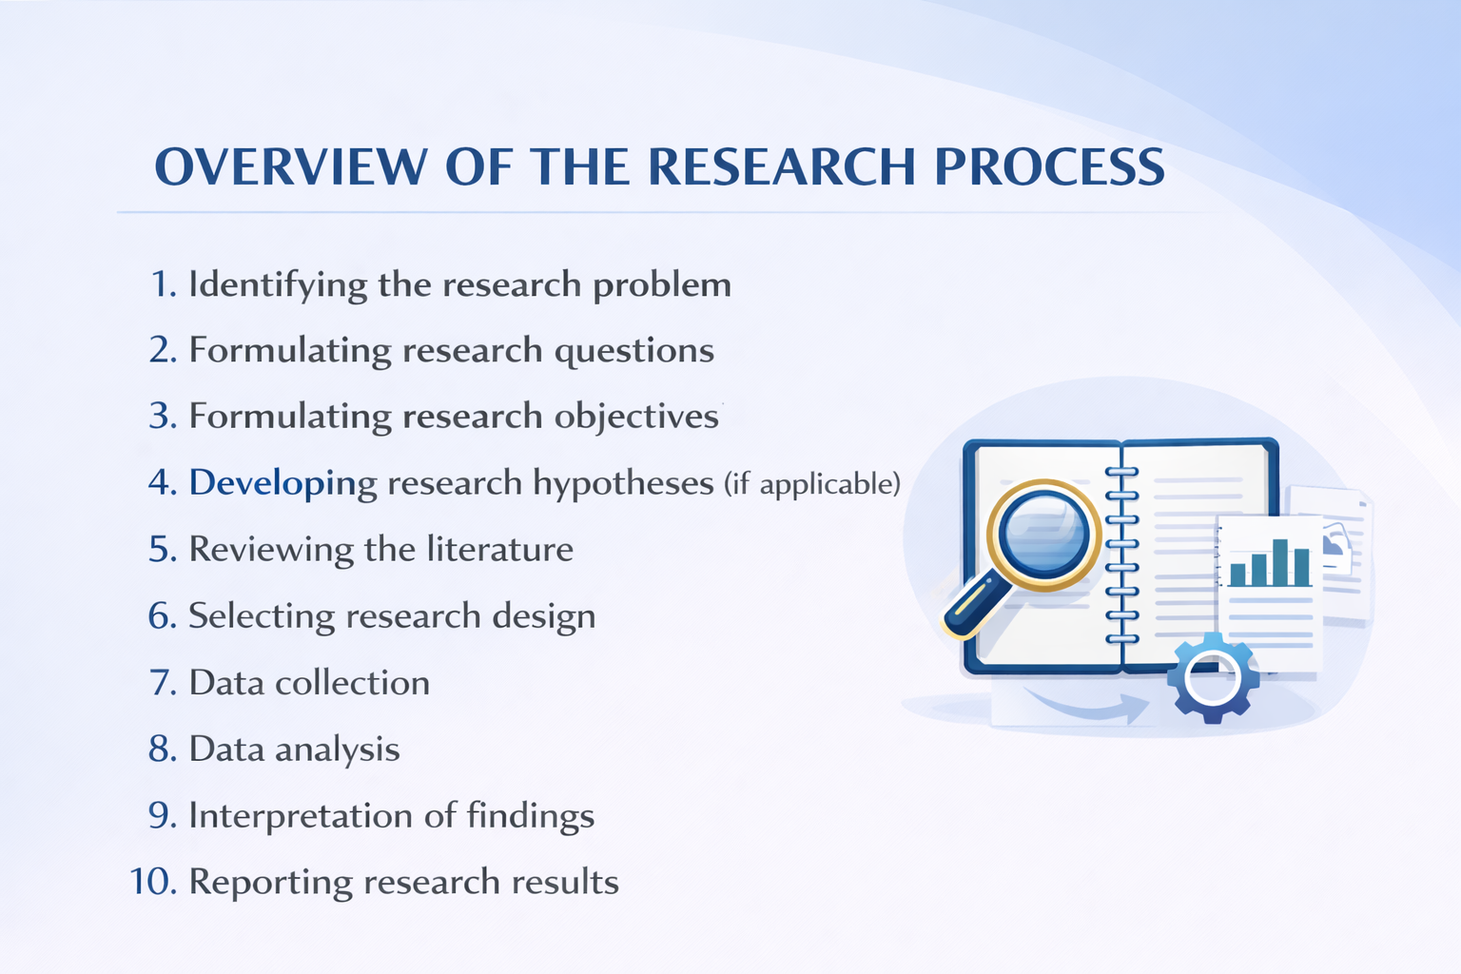
Notes:
Overview of the Research Process
Having understood the importance of systematic research, let us now look at the overall structure of the research process.
Research is carried out through a sequence of interconnected stages. Each stage builds upon the previous one, creating a logical pathway from identifying a research problem to presenting the final results.
The first step is identifying the research problem. This involves recognizing an issue, gap, or phenomenon that requires investigation.
Once the problem has been identified, the researcher proceeds to formulate research questions. These questions guide the direction of the study and clarify what the researcher intends to explore.
The next step is formulating research objectives. Objectives specify the goals that the research seeks to achieve.
In some studies, particularly quantitative research, researchers also develop research hypotheses, which are tentative statements predicting relationships between variables.
After that, the researcher conducts a review of the literature. This step helps to understand previous studies, theoretical perspectives, and gaps in existing knowledge.
Based on this understanding, the researcher then selects an appropriate research design, which determines how the study will be conducted.
The next stage is data collection, where the researcher gathers relevant information using appropriate research instruments and methods.
Once the data has been collected, the researcher performs data analysis in order to identify patterns, relationships, or themes within the data.
Following analysis, the researcher proceeds to interpret the findings, explaining what the results mean in relation to the research questions and the broader field of study.
Finally, the research process concludes with reporting the research results, where the findings and conclusions are presented in a systematic and transparent manner.
Together, these steps form the systematic process of research that ensures the credibility and rigor of academic inquiry.

Slide 5
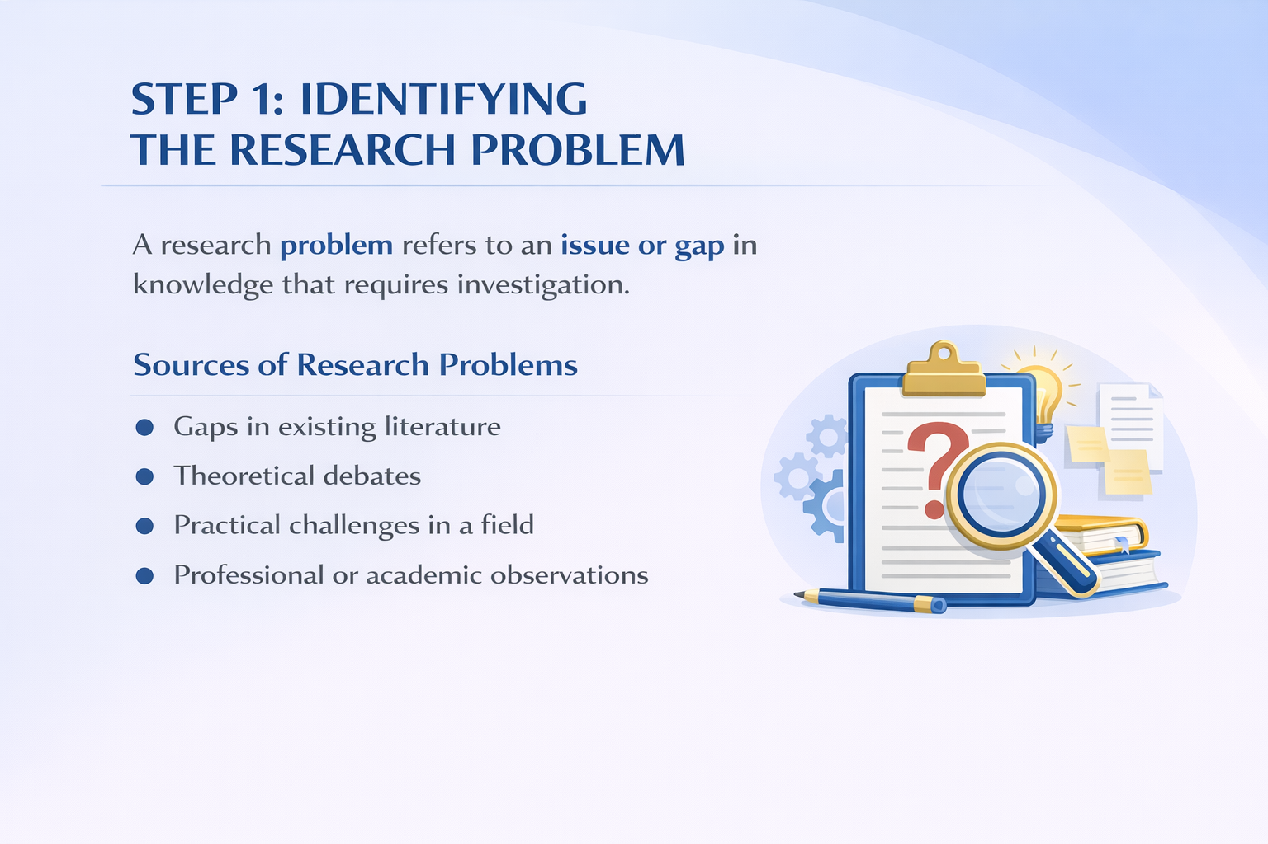
Notes:
Step 1: Identifying the Research Problem
The first step in the research process is identifying the research problem.
A research problem refers to an issue, challenge, or gap in existing knowledge that requires systematic investigation. In other words, it is the central question or concern that motivates the research study.
Identifying a clear and meaningful research problem is extremely important because it determines the direction and focus of the entire research project. A well-defined problem guides the formulation of research questions, objectives, and the overall research design.
Research problems can emerge from several different sources.
One common source is gaps in existing literature. While reviewing previous studies, researchers may notice areas that have not yet been explored or questions that remain unanswered.
Another source is theoretical debates within a field. Scholars often propose different explanations or perspectives, and research can help clarify or test these competing ideas.
Research problems may also arise from practical challenges within a particular professional or social context. For example, issues encountered in education, healthcare, or organizational settings may inspire research inquiry.
Finally, research problems may emerge from professional or academic observations, where researchers notice patterns, phenomena, or trends that require deeper investigation.
Identifying a clear research problem therefore represents the starting point of every successful research study.

Slide 6
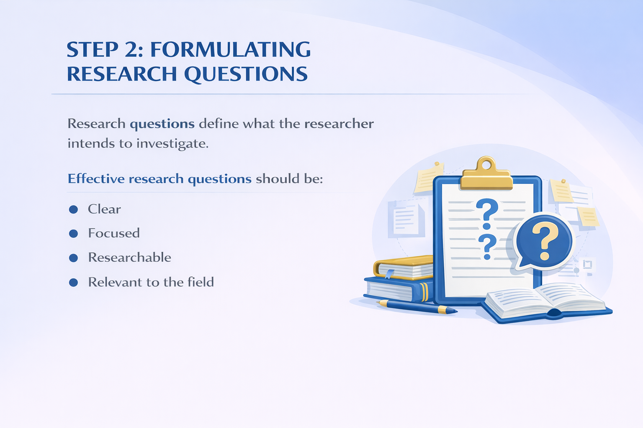
Notes:
Step 2: Formulating Research Questions
After identifying the research problem, the next step in the research process is formulating research questions.
Research questions define what the researcher intends to investigate. They translate the research problem into specific inquiries that guide the direction of the study.
Well-formulated research questions are essential because they determine the focus of the investigation and help the researcher identify the type of data that needs to be collected.
Effective research questions should possess several important characteristics.
First, they should be clear. This means that the questions must be expressed in simple and precise language so that their meaning is easily understood.
Second, research questions should be focused. A focused question addresses a specific aspect of the research problem rather than attempting to cover too many issues at once.
Third, research questions must be researchable. In other words, they should be capable of being answered through systematic data collection and analysis.
Finally, research questions should be relevant to the field of study. They should contribute to existing knowledge and address issues that are meaningful within the academic or professional discipline.
Well-developed research questions therefore serve as a foundation for the entire research process, guiding subsequent stages such as research objectives, research design, and data collection.

Slide 7
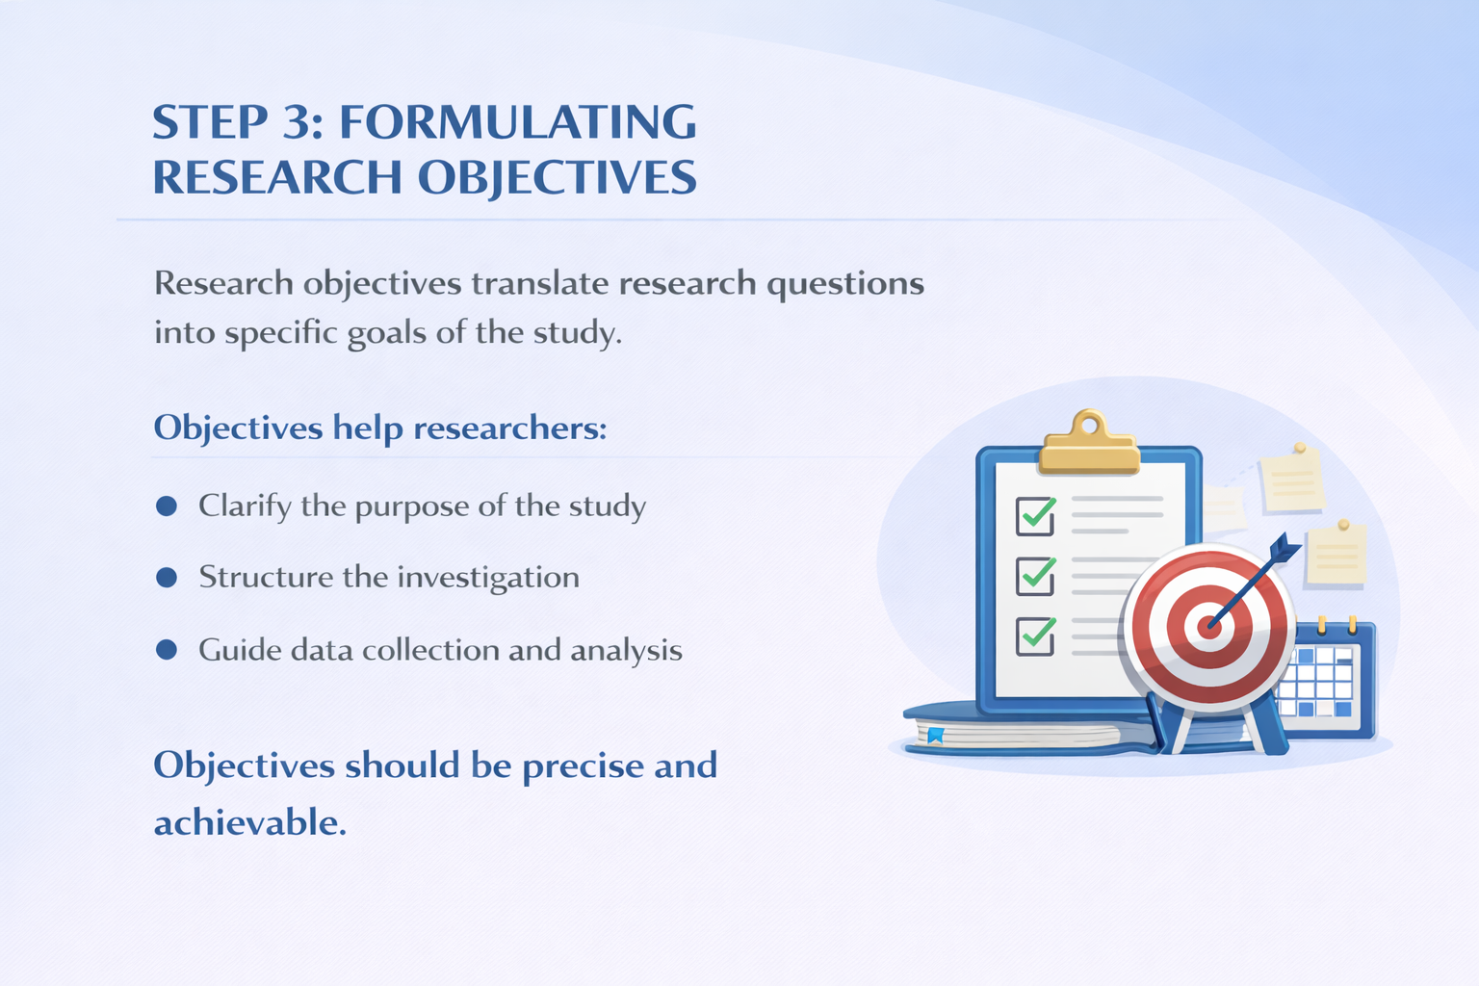
Notes:
Step 3: Formulating Research Objectives
After formulating the research questions, the next step in the research process is formulating research objectives.
Research objectives translate the research questions into specific goals that the study aims to achieve. In other words, while research questions ask what the researcher wants to investigate, research objectives clearly state what the study intends to accomplish.
Well-defined research objectives play a crucial role in guiding the entire research process.
First, research objectives help researchers clarify the purpose of the study. They make it clear what the research is trying to accomplish and what outcomes the researcher expects to achieve.
Second, objectives help to structure the investigation. By defining clear goals, the researcher can organize the study in a systematic and logical manner.
Third, research objectives also guide data collection and data analysis. They help determine what type of data needs to be collected and how that data should be analyzed in order to answer the research questions.
It is important that research objectives are precise and achievable. Clear and realistic objectives ensure that the research remains focused and manageable throughout the study.
Thus, well-formulated research objectives serve as an essential bridge between the research questions and the methodological design of the study.

Slide 8
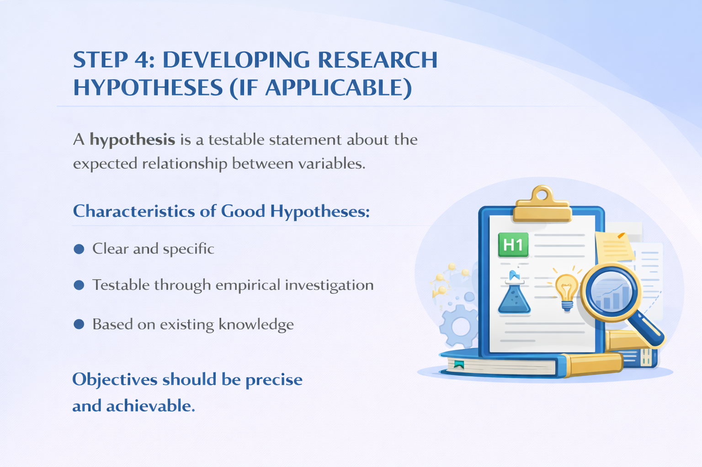
Notes:
Step 4: Developing Research Hypotheses
The next step in the research process is developing research hypotheses, particularly in studies that follow a quantitative research approach.
A hypothesis is a testable statement that predicts the expected relationship between two or more variables. In simple terms, it represents a tentative explanation or assumption that the researcher seeks to examine through empirical investigation.
Hypotheses play an important role in guiding the research process because they provide a clear direction for data collection and analysis. By proposing a possible relationship between variables, hypotheses help researchers determine what kind of evidence needs to be gathered.
A good research hypothesis should possess several important characteristics.
First, it should be clear and specific. The hypothesis must clearly state the variables involved and the expected relationship between them.
Second, a hypothesis must be testable through empirical investigation. This means that the statement should be capable of being examined through systematic data collection and analysis.
Third, a hypothesis should be based on existing knowledge. Researchers usually develop hypotheses after reviewing relevant literature and theoretical perspectives within the field.
Therefore, well-developed hypotheses help researchers transform theoretical ideas into empirically testable propositions, which can then be examined through the research process.

Slide 9
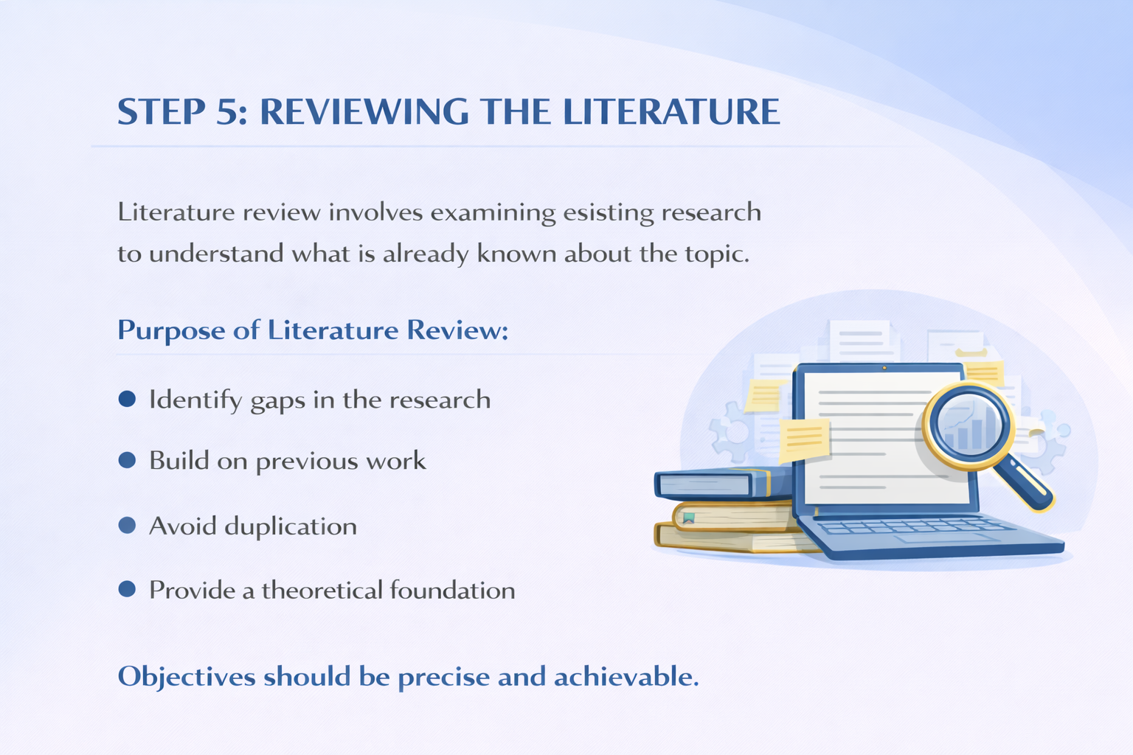
Notes:
Step 5: Reviewing the Literature
The next step in the research process is reviewing the literature.
A literature review involves examining existing research studies, scholarly articles, books, and other academic sources in order to understand what is already known about the research topic.
Through this process, researchers become familiar with the current state of knowledge in their field and identify the major theories, findings, and debates related to their research problem.
The literature review serves several important purposes.
First, it helps researchers identify gaps in the existing body of research. By examining previous studies, researchers can determine which aspects of a topic have already been explored and which areas still require further investigation.
Second, reviewing the literature allows researchers to build on previous work. Rather than starting from the beginning, researchers extend and refine the knowledge that has already been developed by earlier scholars.
Another important purpose of the literature review is to avoid unnecessary duplication of research. By understanding what has already been studied, researchers can design studies that contribute something new to the field.
Finally, the literature review helps to provide a theoretical foundation for the study. It enables researchers to situate their work within established theoretical frameworks and scholarly discussions.
In this way, the literature review plays a critical role in ensuring that the research is well-informed, academically grounded, and relevant to the field of study.

Slide 10
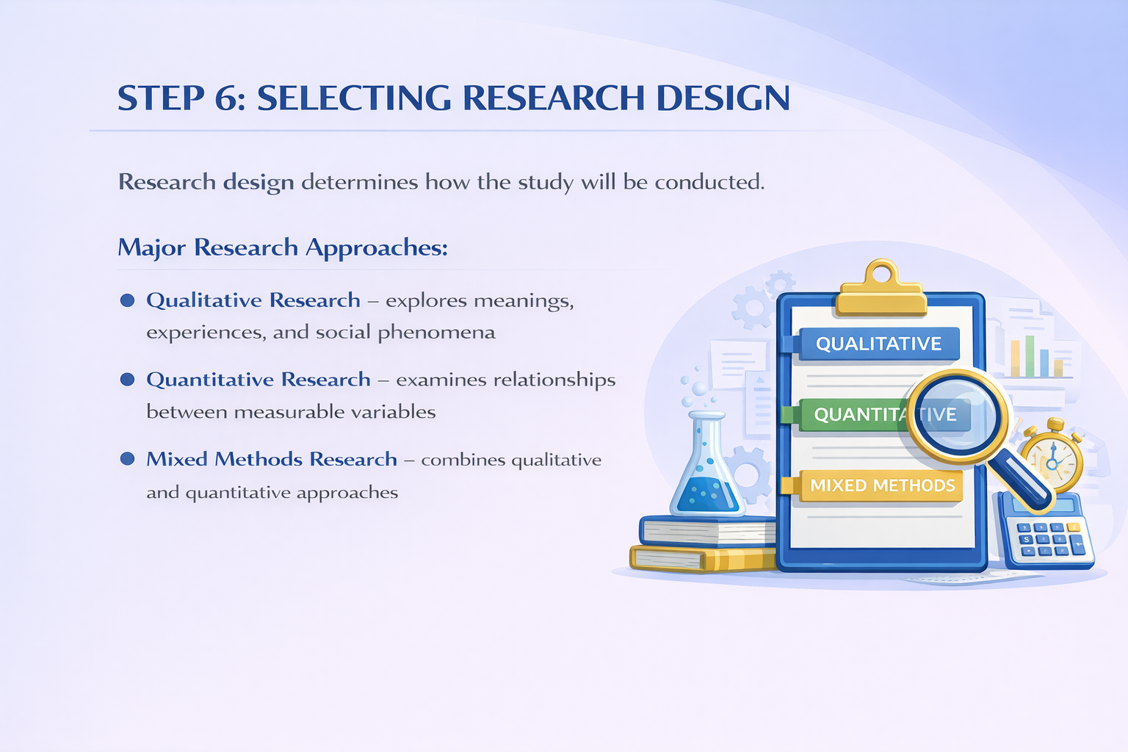
Notes:
Step 6: Selecting Research Design
At this stage of the research process, the researcher must select an appropriate research design.
Research design refers to the overall strategy or plan that guides how the research will be conducted. It determines how data will be collected, analyzed, and interpreted in order to answer the research questions.
In contemporary research methodology, three major research approaches are commonly recognized.
The first approach is qualitative research. Qualitative research focuses on understanding meanings, experiences, and social phenomena. It often involves methods such as interviews, observations, and document analysis.
The second approach is quantitative research. Quantitative research examines relationships between measurable variables using numerical data and statistical analysis.
The third approach is mixed methods research. Mixed methods research combines both qualitative and quantitative approaches in order to provide a more comprehensive understanding of the research problem.
Selecting an appropriate research design is therefore a critical step in ensuring that the research process is logically structured and methodologically sound.

Slide 11

Notes:
Step 7: Data Collection
At this stage of the research process, the researcher proceeds to data collection.
Data collection refers to the systematic process of gathering information that is relevant to the research questions and objectives of the study. The purpose of this stage is to obtain reliable evidence that will allow the researcher to answer the research questions.
There are several commonly used data collection methods in research.
One widely used method is the questionnaire, often administered through surveys. Questionnaires consist of structured sets of questions designed to collect responses from a large number of participants, particularly in quantitative research.
Another important method is interviews. Interviews allow researchers to obtain detailed information directly from participants. Interviews may be conducted individually, or in the form of focus group interviews, where several participants discuss a topic together.
Researchers may also use observations as a data collection method. Observation involves systematically recording behaviors, events, or interactions in natural or controlled settings.
Finally, researchers may analyze documents or existing data. This can include reports, institutional records, archival materials, or previously published data sources.
The choice of data collection method depends on the research design, research questions, and the nature of the data required.

Slide 12
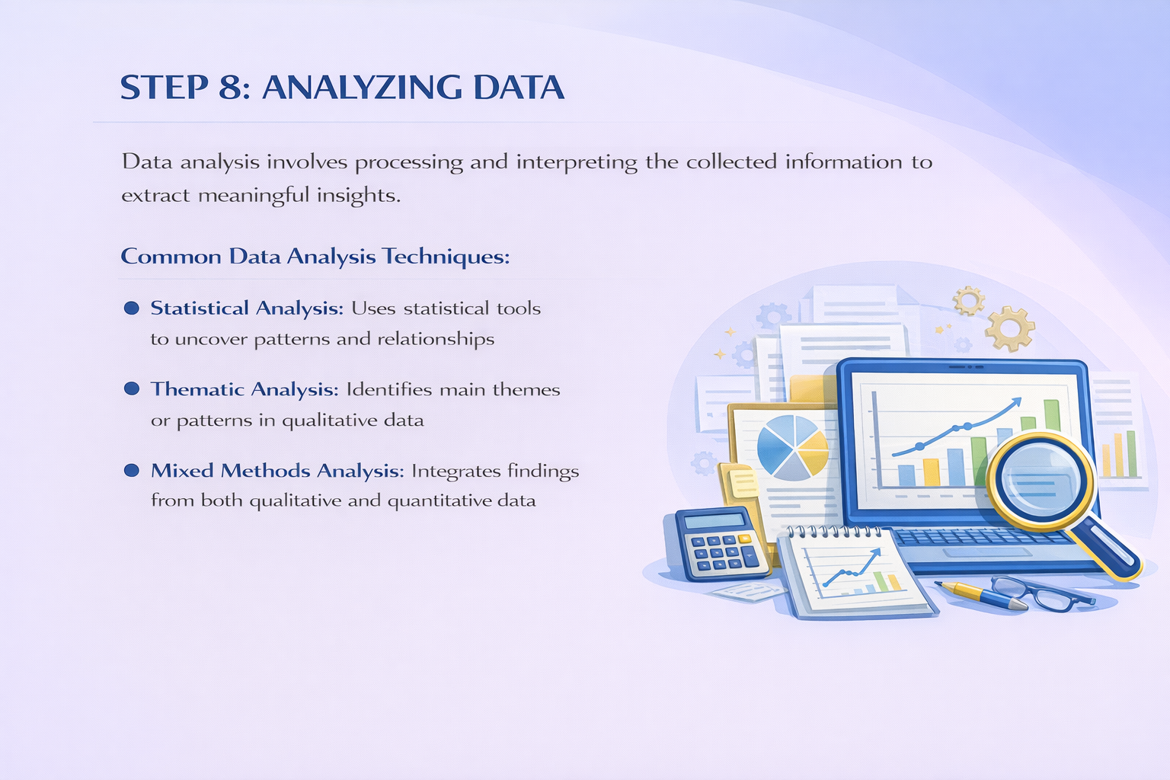
Notes:
Step 8: Analyzing Data
After collecting the data, the researcher moves to the next stage of the research process, which is data analysis.
Data analysis refers to the systematic process of examining, organizing, and interpreting the collected information in order to answer the research questions and achieve the research objectives.
The purpose of data analysis is to transform raw data into meaningful insights that contribute to the understanding of the research problem.
There are several common approaches to analyzing research data.
In quantitative research, researchers often use statistical analysis. Statistical analysis involves applying mathematical and statistical techniques to identify patterns, relationships, and differences within numerical data.
In qualitative research, researchers commonly use thematic analysis. Thematic analysis involves identifying recurring themes, concepts, or patterns within textual or narrative data such as interview transcripts or observation notes.
In mixed methods research, researchers may combine both qualitative and quantitative analytical techniques. This approach allows them to integrate different types of data in order to gain a more comprehensive understanding of the research problem.
Through careful and systematic analysis, researchers are able to interpret their findings and move toward meaningful conclusions.

Slide 13
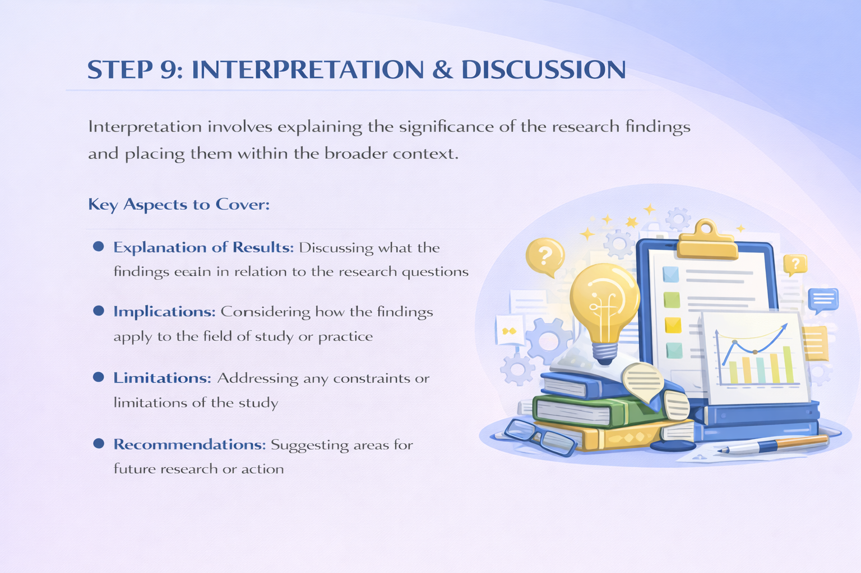
Notes:
Step 9: Interpretation and Discussion
After completing the data analysis, the researcher proceeds to the next stage of the research process, which is interpretation and discussion of the findings.
Interpretation involves explaining the meaning and significance of the research results. At this stage, the researcher examines what the findings actually indicate in relation to the research questions and objectives.
The first important aspect is the explanation of results. Here, the researcher discusses how the findings answer the research questions and how they relate to the theoretical framework and previous studies discussed in the literature review.
The second aspect involves discussing the implications of the findings. This means considering how the results contribute to the field of study and how they may influence theory, practice, or policy.
Another important element is identifying the limitations of the study. Every research project has certain constraints, such as limitations related to sample size, research context, or methodological choices. Acknowledging these limitations helps maintain academic transparency.
Finally, the researcher may provide recommendations. These recommendations may suggest directions for future research or practical actions that can be taken based on the study's findings.
Through careful interpretation and discussion, researchers connect their findings to the broader academic and practical context.

Slide 14

Notes:
Step 10: Reporting Research Findings
The final stage of the research process is reporting the research findings.
At this stage, the researcher communicates the results of the study to the academic community and other relevant audiences. The purpose of reporting is to present the research outcomes in a clear, systematic, and transparent manner so that others can understand, evaluate, and potentially build upon the study.
An effective research report should clearly present the findings. This involves organizing the results logically and presenting them in a way that directly addresses the research questions and objectives.
Another important aspect is providing evidence-based conclusions. The conclusions drawn from the study should be supported by the data collected and the analysis conducted during the research process.
Researchers must also consider the audience when presenting their findings. Depending on the audience—such as academic scholars, policy makers, or practitioners—the presentation of results may need to be adapted for clarity and relevance.
Finally, a research report must include appropriate references. Proper citation acknowledges previous scholarship and ensures academic integrity.
Through clear and systematic reporting, research contributes to the advancement of knowledge and supports further inquiry within the field.

Slide 15
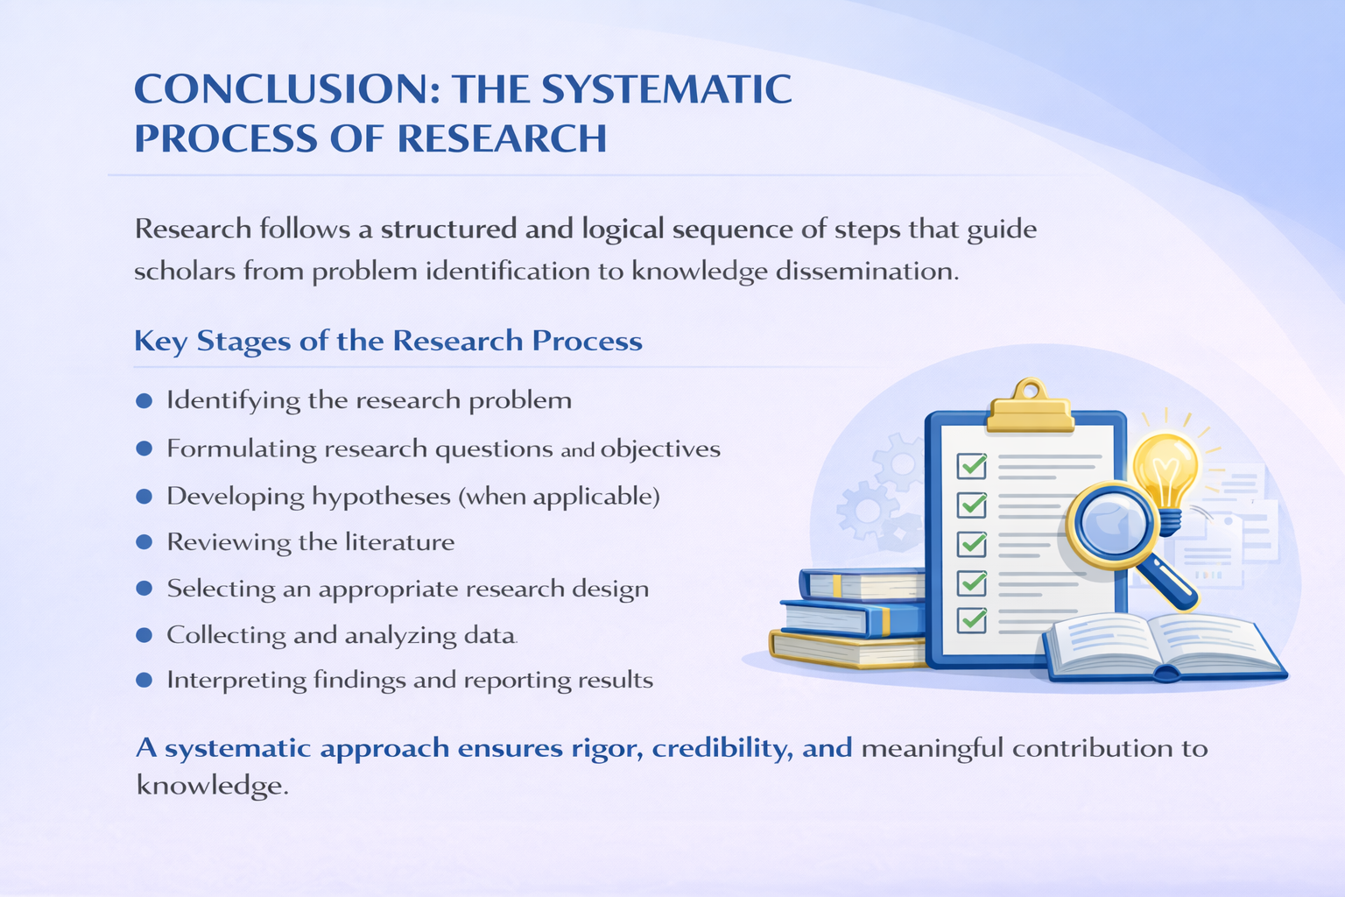
Notes:
Conclusion
Let us now briefly summarize what we have discussed in this lecture.
Research is not a random activity. It follows a systematic and organized process that guides scholars from the identification of a problem to the presentation of research findings.
We began by understanding the meaning and characteristics of research, emphasizing that research must be systematic in order to produce reliable and valid knowledge.
We then examined the major stages of the research process. These stages include identifying the research problem, formulating research questions and objectives, and, when appropriate, developing research hypotheses.
After defining the focus of the study, researchers conduct a literature review in order to understand existing knowledge and identify gaps that require further investigation.
The next stages involve selecting an appropriate research design, collecting relevant data, and analyzing that data in order to answer the research questions.
Finally, researchers interpret their findings and report the results, thereby contributing new knowledge to the academic community and society.
Understanding this systematic process is essential for conducting rigorous, credible, and meaningful research, particularly at the doctoral level.
With this overview of the systematic process of research, we conclude this lecture. Thank you for your attention.

